Slide 1

Career Roadmaps
Name: Kunal Goyal
Course: BCA-V EVE
Enrolment: 03421102019

Slide 2
About Career Roadmaps
The Title of the Project is the “Career Roadmaps” to move towards the technology in the right direction.
Every Student or a working professional faces problems such as:
What to be learned in that technology?
How to learn the technology?
How to move in the right direction?
How to grow in the particular technology?
How much time it would take to learn the technology?
From what point we should start learning the technology?
Where are the best resources available for that technology?
Is technology chosen by me is right or not?
But there’s no such right, trustworthy and complete information provided at a single source.
So to solve this problem there comes the Career Roadmaps.
A Roadmap is very important aspect in one’s career to follow the right path so that one can achieve their goals effectively and efficiently in the right manner.

Slide 3
What is a Roadmap ?
A Roadmap is a visual flowchart or visual representation of data that helps one to get all the information required about something in the easiest possible way.

Slide 4
Features of Career Roadmaps
Career Roadmaps allows you to choose between different technologies, it’s not just limited to the technical path it also helps people to learn different aspects of career such as Graphics Design or Animation.
Career Roadmaps consists of different modules:
Fields
Technologies
Area of Work
Contact Us Section
Login Section
Sign Up Section
Career Roadmaps consists of different fields such as Development, Motion Design and Animation and Graphics Design.
Career Roadmaps consists of different technologies such as Web Development App Development and many more.
Career Roadmaps consists of different area of work such as Front-End, Back-End, Full Stack and many more.

Slide 5
SRS of the Project
Project planning is part of project management, which relates to the use of schedules such as Gantt charts to plan and subsequently report progress within the project environment. Initially, the project scope is defined and the appropriate methods for completing the project are determined. Following this step, the durations for the various tasks necessary to complete the work are listed and grouped into a work breakdown structure. The logical dependencies between tasks are defined using an activity network diagram that enables identification of the critical path.
SRS includes listing of the modules such as:
Fields
Technologies
Area of Work
The action performed by the end user and the admin such as:
View Roadmaps, referral websites and courses available
Contacting for any Queries through Contact us feature
Updating data and information about different technologies and fields etc.
Designing of the roadmaps, website layout, website logo.
Detailed listing of technologies and fields

Slide 6
Methodology of the Project
Software development life cycle model used in the project is the Prototype model.
What is Prototype Model?
The Prototype Model is the advancement of the older Models as the problem with the older models is that the Customer cannot see the working project till the end of the development process which can lead to project failure, thus it is better to use Prototype model so that the customer can take a look at the working prototype during the development process.
In this model, the sequence of activities are:
Requirements gathering and analysis
Quick Design
Build Prototype
User Evaluation
Refining Prototype
Engineer Product

Slide 7
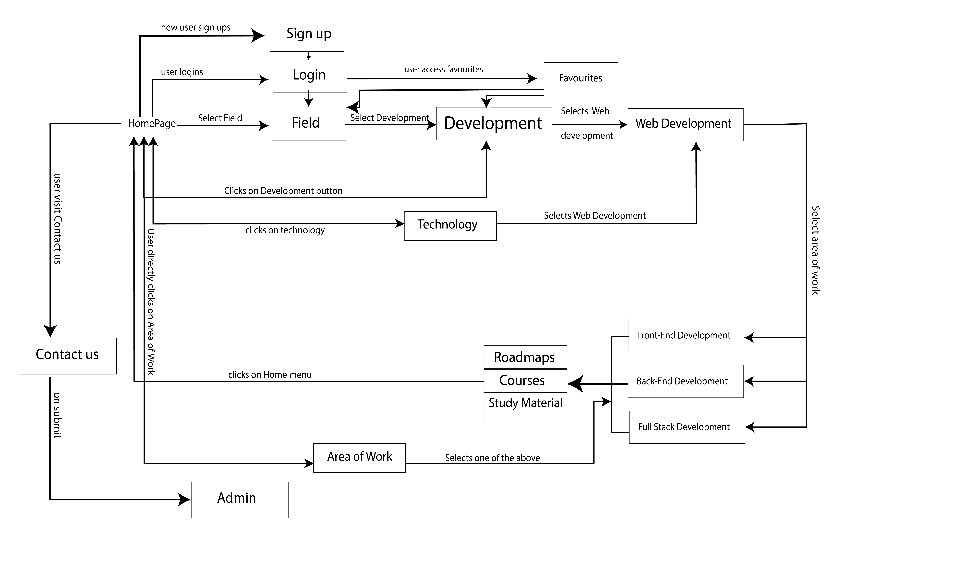
Block Diagram of Career Roadmaps

Slide 8
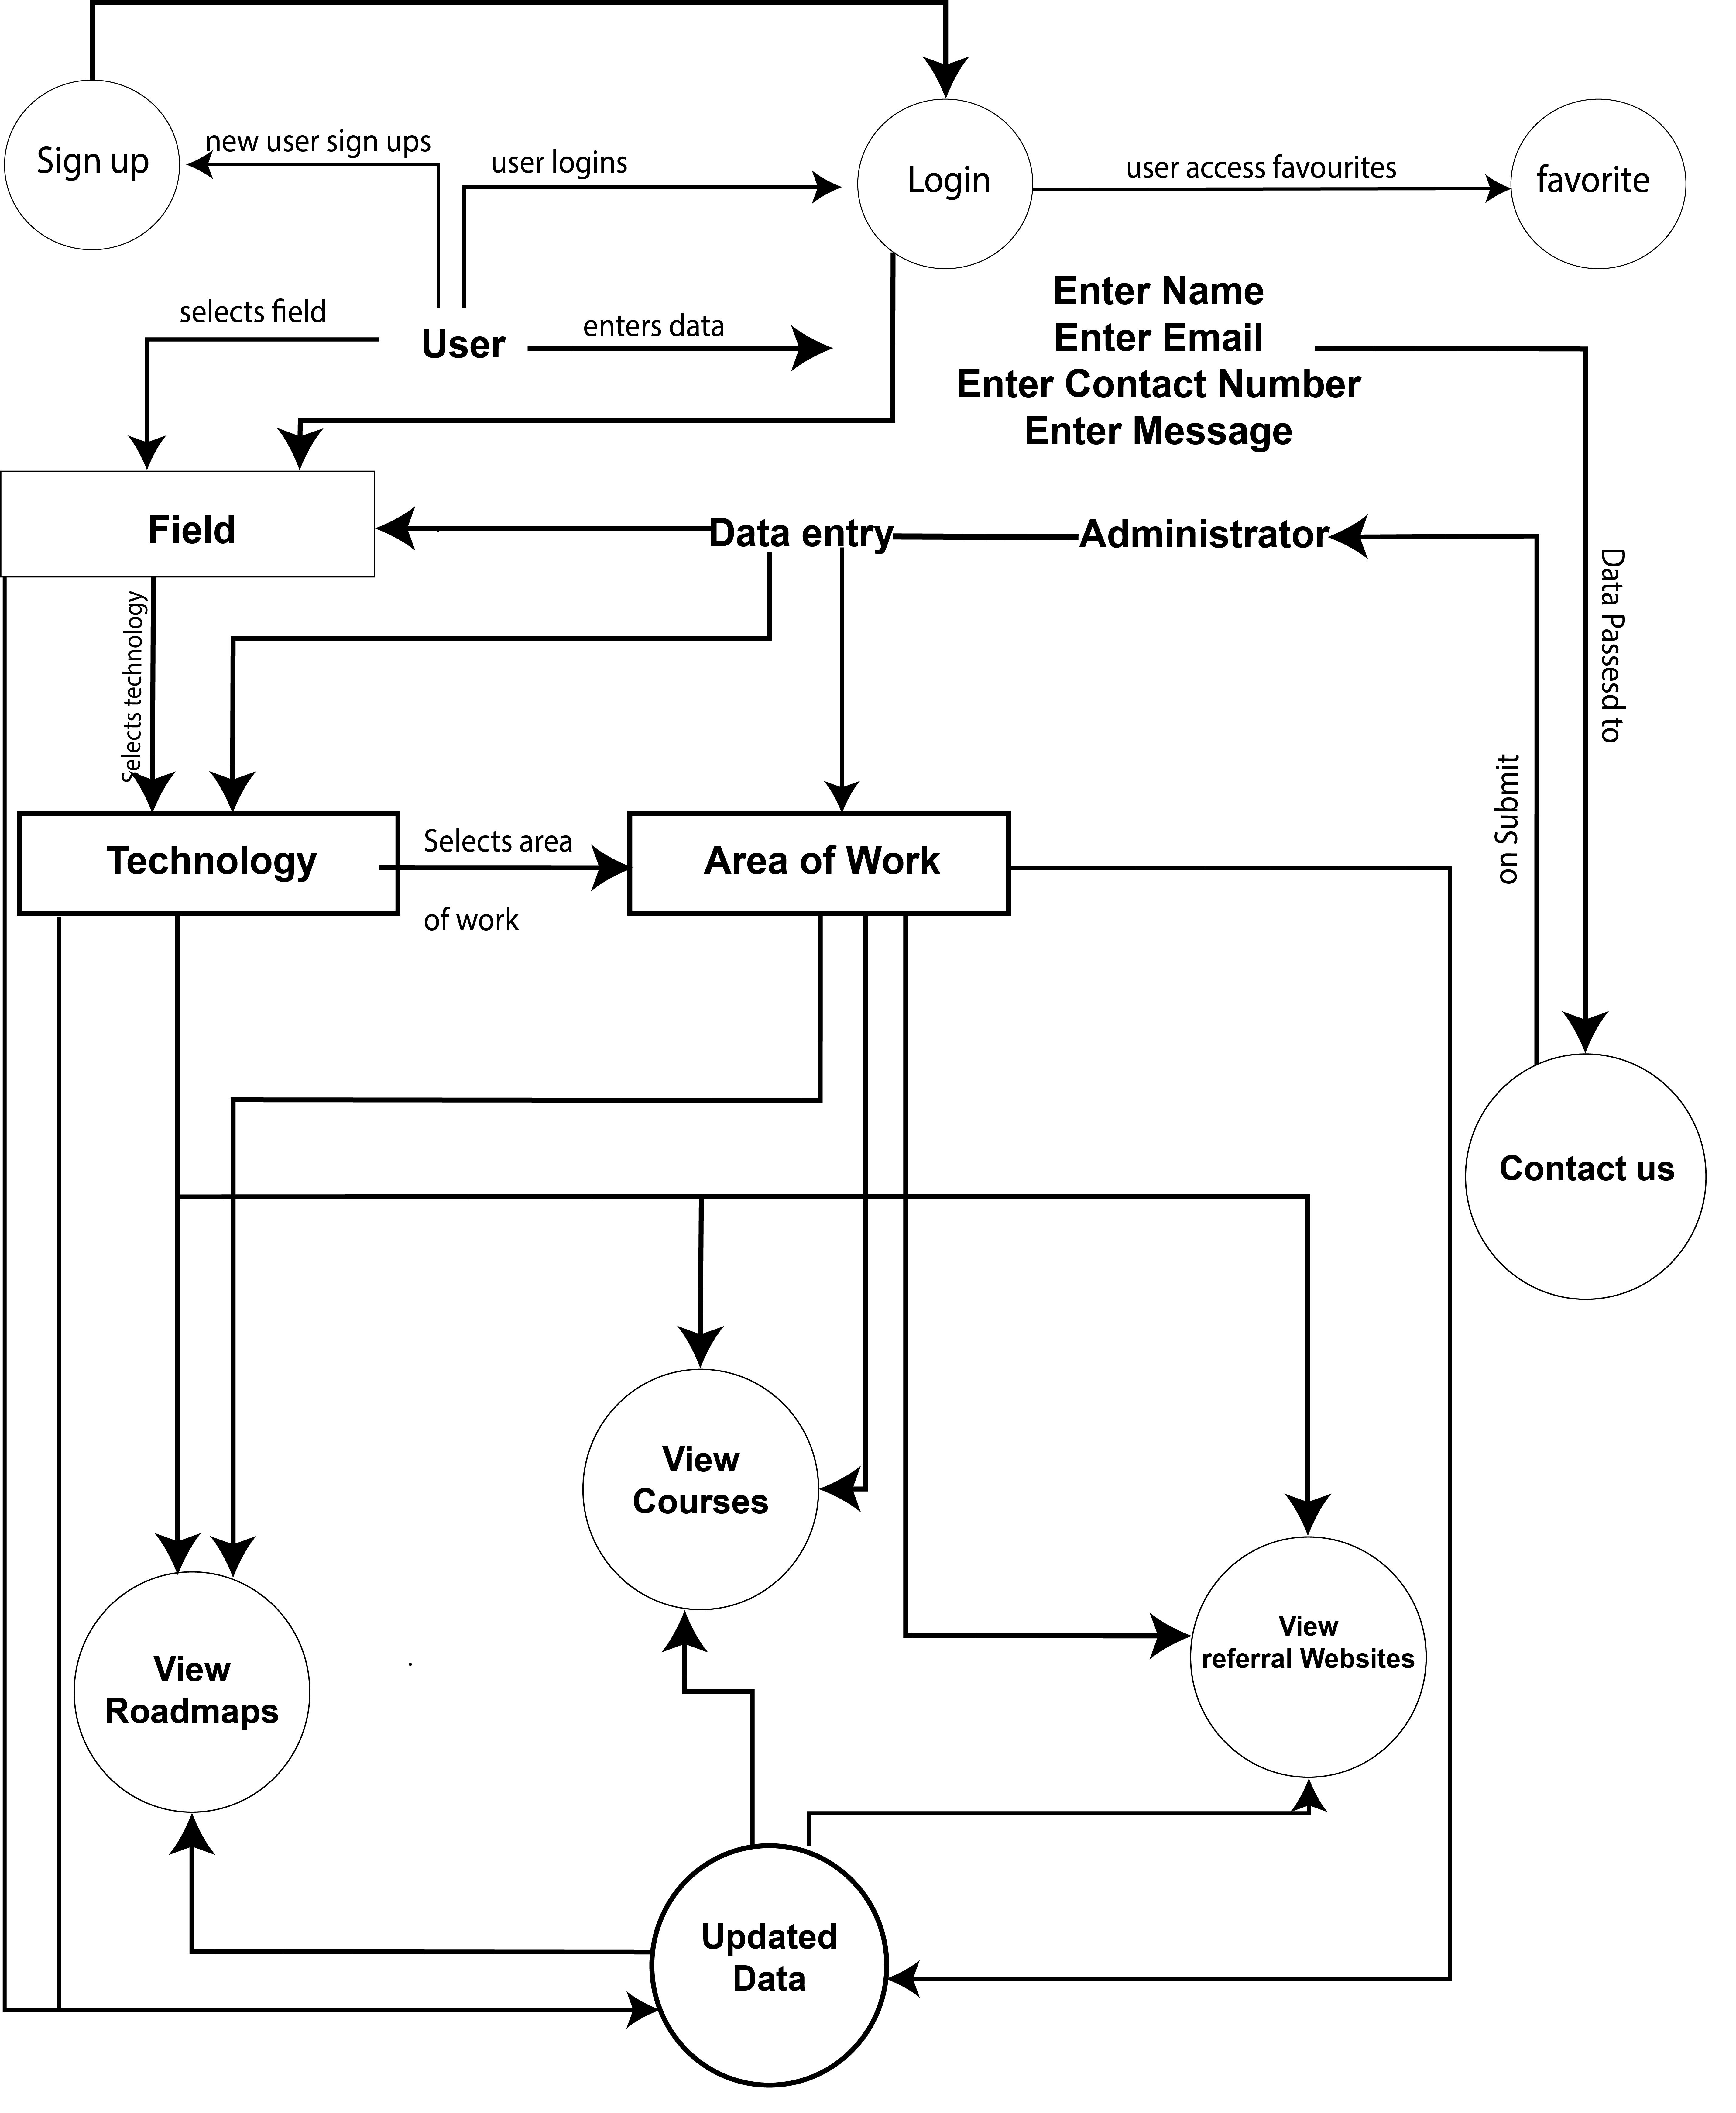
DFD of Career Roadmaps

Slide 9
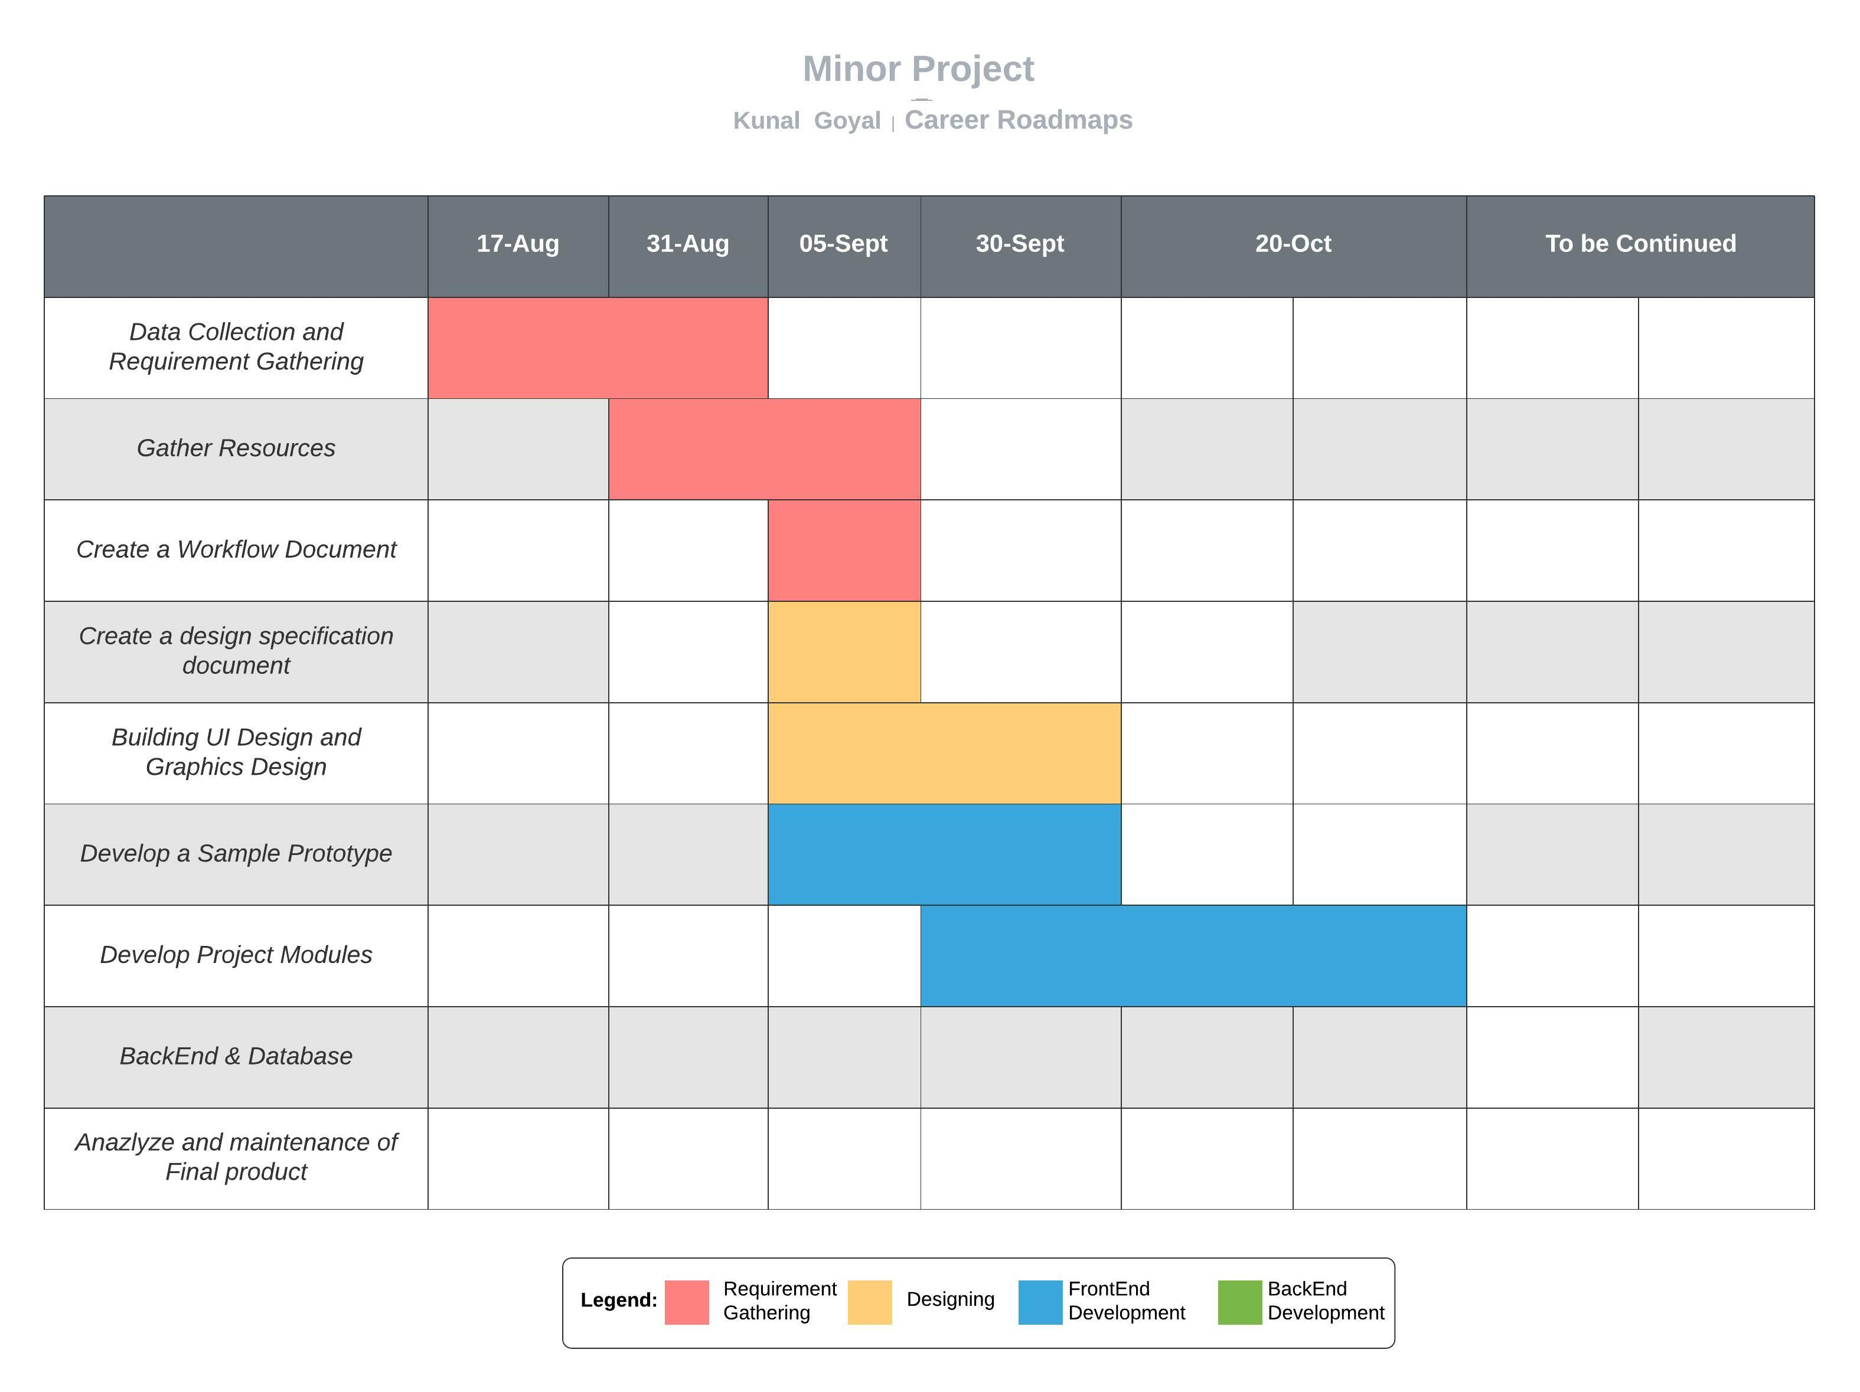
Gantt Chart of Career Roadmaps

Slide 10
References used
Geeks for Geeks
W3Schools
Java-t-Point
The Verge
Wikipedia
Studio Binder
Vmg Studios

Slide 11
Thank you Kunal Goyal

